Slide 1

The Kaleidoscope Behaviour curriculum.

Slide 2
Welcome to our parents.

Slide 3


Slide 4

The rationale behind the idea...
As humans, our brains make sense of the world by either learning stories about the world told us by others (the most common route to cultural understanding), then (having internalised these stories) making up stories of our own – our internal monologue which we use to rationalise a chaotic world into a coherent narrative of our lives.
Learning behaviour routines are the first step of this narrative that is a life-long journey.

Slide 5
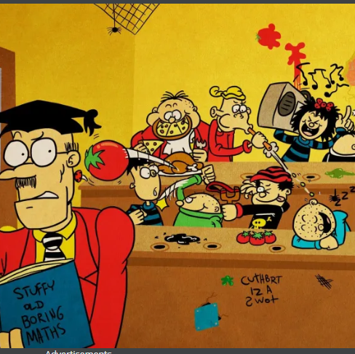
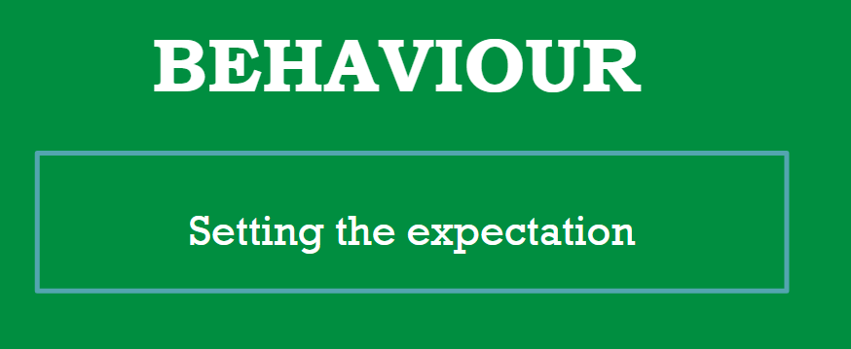
Were going to teach how to behave.

Slide 6
As Ofsted explains:
“High expectations for behaviour and attitudes should include the development of core values such as respect for self and others, resilience and motivation to succeed.” Positive learning behaviour is about creating an environment where students are encouraged to take ownership of their learning.

Slide 7
What is it?
A new curriculum very much like English or Maths.
It has a set of set routines to follow that become expectations of behaviour.
Each routine has a set of simple steps that will be taught just like writing a sentence or calculating a sum.
Pupils will be told why they are learning it so they understand.
It will be practised at all times and be consistent across the school and academy.

Slide 8
They are not rules as these can be broken
They are expectations of behaviour that soon develop into the norm around the school.

Slide 9
EVIDENCE BASED RESEARCH USING REAL LIFE EXPERTS:
The Education Endowment Foundation’s no-nonsense ‘Improving Behaviour in Schools’ report.
Paul Dix’s excellent book ‘When the adults change, everything changes’.
Tom Bennett’s excellent book ‘Running the Room’.
Dixons Academy - https://dixonsos.com/

Slide 10
Why is positive behaviour so important?
The way students behave in school is strongly correlated with their eventual outcomes.
When behaviour in general improves throughout a school the impact is:
• students achieve more academically and socially
• time is reclaimed for better and more learning
• staff satisfaction improves, retention is higher, recruitment is less problematic
children are more likely to feel safe and happy at school

Slide 11
Our three new behaviour expectations:
BE RESPECTFUL
BE READY
BE SAFE
THESE WILL BE VISIBLE AROUND THE SCHOOL AT ALL TIMES

Slide 12
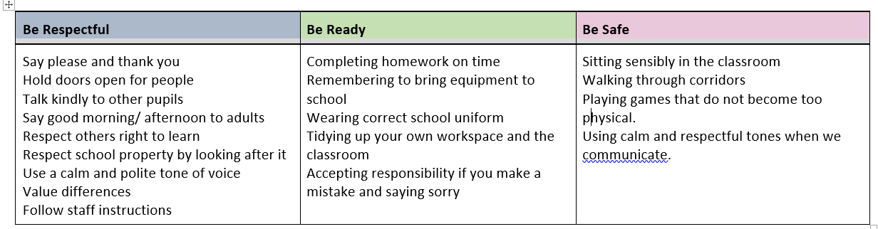
EXAMPLES OF WHAT IT WOULD LOOK LIKE IN OUR SCHOOLS

Slide 13
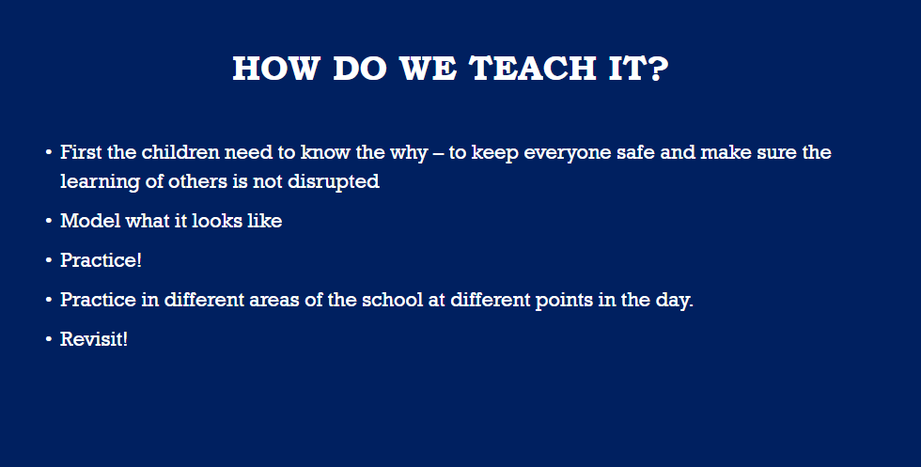

Slide 14
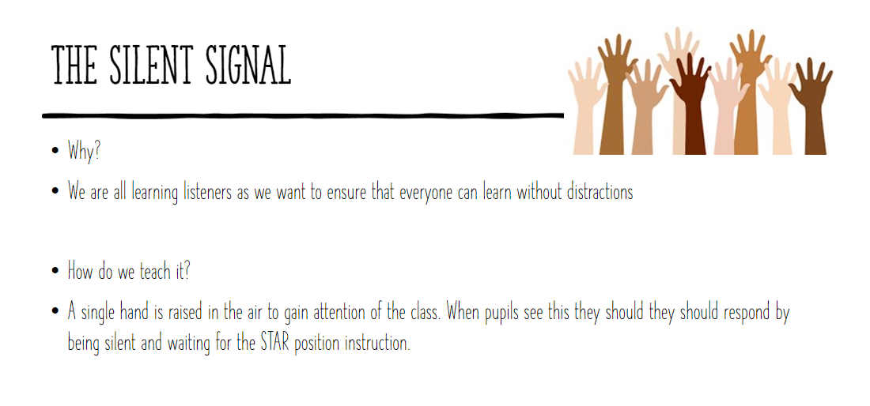
Routine number 1
The silent signaller.

Slide 15
The next steps…
The next routines are:
Wonderful Walking
Careful contributing
Arriving at the beginning of the day
Transitioning within a lesson or at the end of the lesson
Using good manners
Lunchtime
Completing work in my books
End of the day routine
General classroom expectations
See behaviour curriculum document for breakdown of the steps.

Slide 16

100% all staff consistency

Slide 17
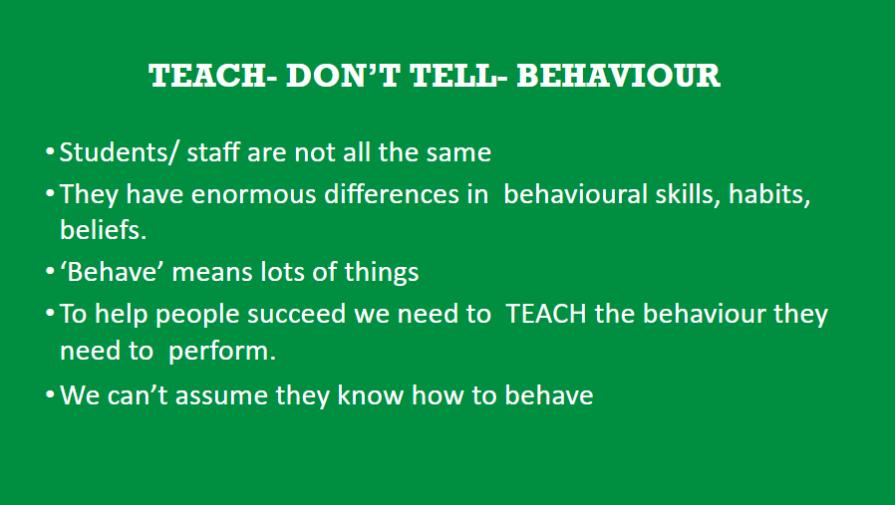
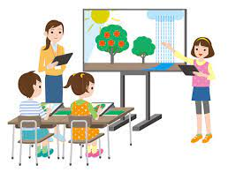

Slide 18
What about the children who might find it a challenge with these routines?
Identified children will have success plans created for them designed by all staff that support the child.
These plans will adapt the routine for them that still allows them to follow them.
The same high expectation is applied

Slide 19
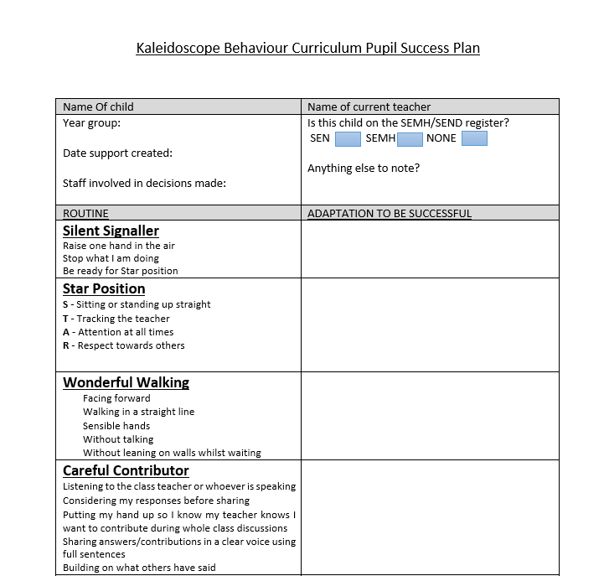
Draft Success Plan

Slide 20
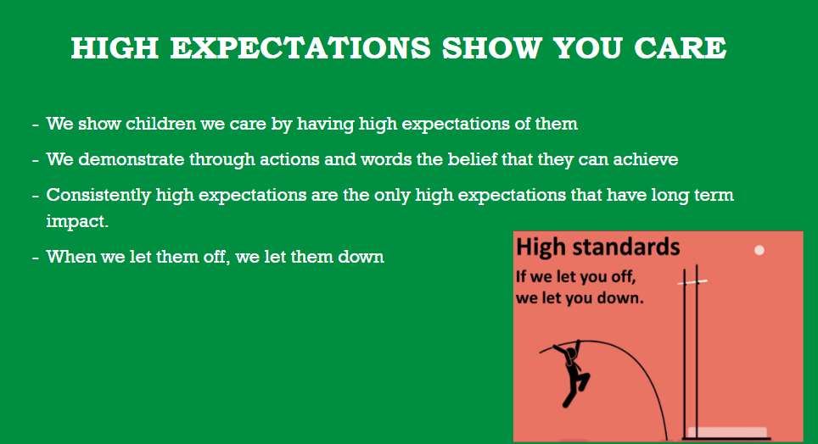

Slide 21

Pupils spoke really positively about the new routines and the impact these have had on behaviour.
‘There’s more time for learning now’
‘It’s definitely better now - we know what to do’
‘Line order helps as we aren't next to people who distract us. The teachers know where to put us’
‘The transition routine is good cause before we would start chatting and then we’d have to start again’
‘We know what we have to do to be good now’

Slide 22
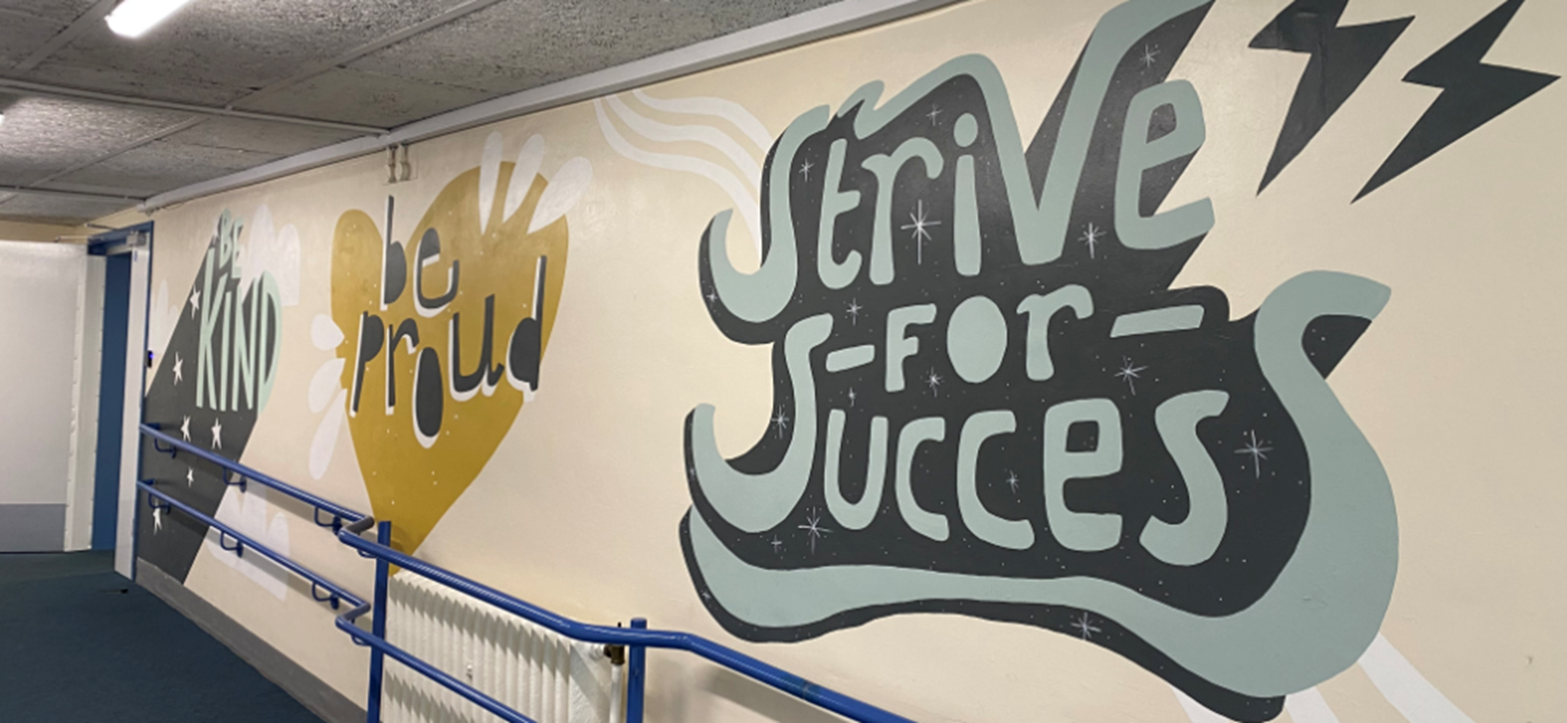
WE HOPE TO MAKE THE PRINCIPLES CLEAR TO SEE FOR EVERYONE.

