Slide 1
KMAT CONSEQUENCES
2023-2024

Slide 2
Foreword
Consequences can be determined as:
1. A reinforcement – used to encourage the behaviour in the future, more frequently
2. a stimulus to discourage behaviour
What is the purpose of a consequence?
They have one primary useful effect ; they deter. They give pause for reflection and make the recipient think, as they sit there “I might not do this again.”
Tom Bennett
Researched in line with Stokes Park Primary School, Paul Dix, Tom Bennett, DFE Behaviour in school guidance 2022

Slide 3
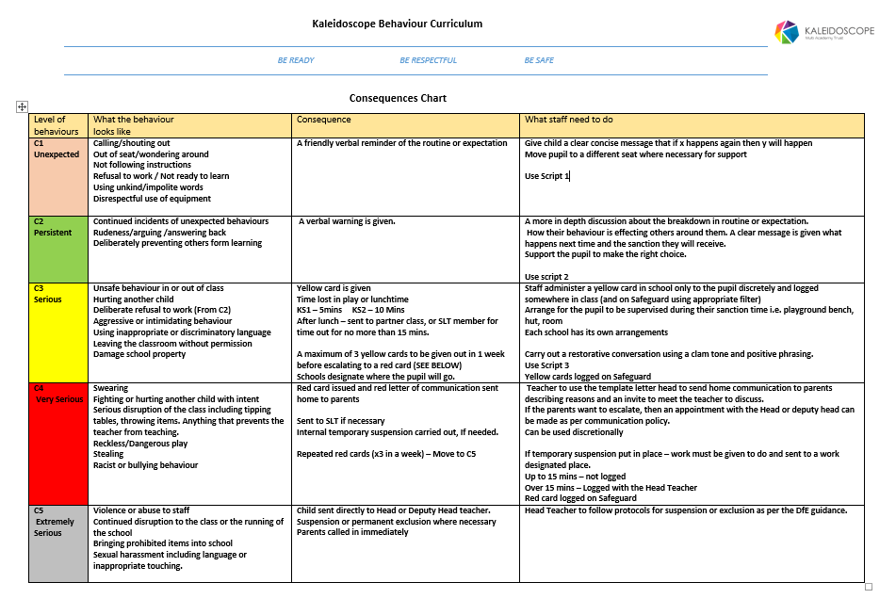
School/Staff full Version

Slide 4
SCRIPTS
  A script is simply a prepared set of responses or phrases to say in order to cope with a situation as efficiently as possible. By having these a teacher can react efficiently.
  A script is not:
  A ritual to be followed slavishly, not a straight jacket and should not be replace sincerity or professionalism
  They are not the last word in perfect responses
  They might not be the right thing to say in any given circumstance, the minute you think of something better to say , you use that instead.

Slide 5
A script …
Gives adults preparation to handle a situation in a calm and focussed manner
It minimises errors generated when having to think on one’s feet
You say what needs to be said but in a pastoral supportive way;
SCRIPTS CAN AND SHOULD be ad-libbed to suit the circumstance as long as you stick to the main points.
The more you use them, the less you need them as they assimilate into your normal conversation.

Slide 6
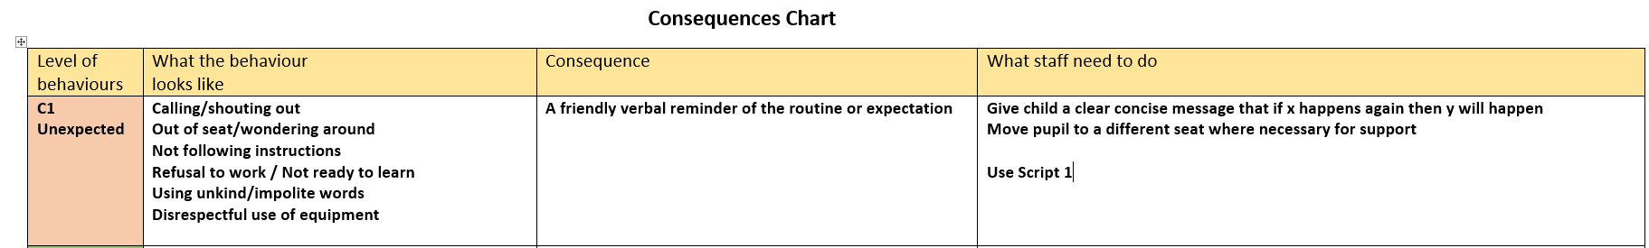
C1 - Unexpected
Teachers can use their judgement and discretion when giving this consequence. It might be that some children need a couple of reminders before moving to C2
Not exhaustive lists used.

Slide 7
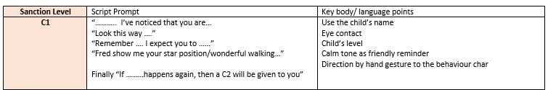
Script 1

Slide 8
C2 - Persistent
The same applies to this stage and positive reinforcement of they can make the right choice before moving to C3.

Slide 9
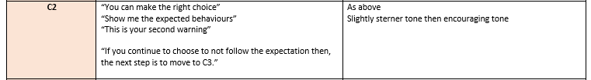
SCRIPT 2

Slide 10
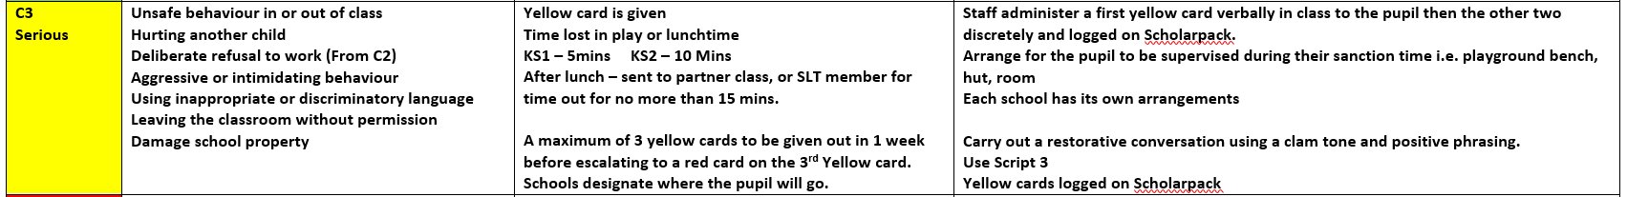
C3 - Serious
C3 begins the issuing of cards.
They have had all the warnings and reminders.
At each card stage a restorative conversation should be had to support the expectations and deter from the second card.
The first yellow card will be verbalised to the child then the second and third will be discretely given.

Slide 11
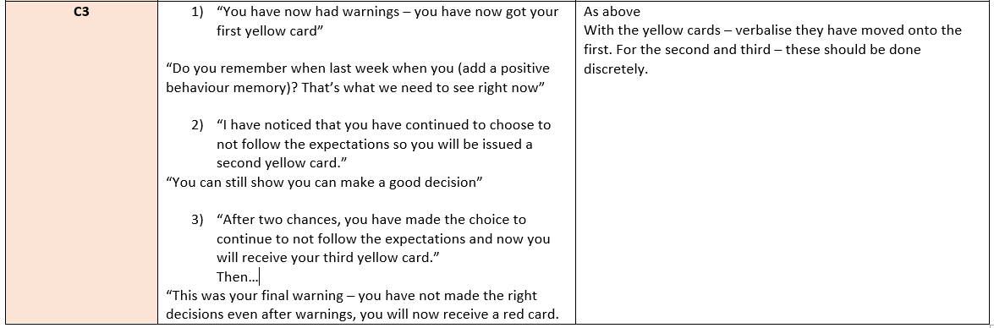
Script 3

Slide 12
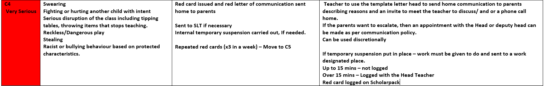
C4 – Very serious
A red letter can be sent to parents based on the teacher’s judgement.
The actual red card issued may be enough deterrent for the pupil.
The discussion about it with parents should be made by appointment rather than in the playground.
If a red card is received on a Friday afternoon, then the consequence will be carried over to the Monday of the next week and explained to both pupil and parent.

Slide 13
C5 – Extremely Serious
Please note that incidents can move straight to C4 or C5 based on the severity of the action.

Slide 14
Key points to remember:
The consequences are designed for both the behaviour curriculum routines and everyday behaviours/expectations.
It is not set in stone and teacher’s professional judgement is key – they know the pupils.
It is not a race to move through the stages to C5.
It is more about supporting conversations at each stage to prevent the pupil from moving onwards.
Every member of staff will be trained using the same consequences and language with the same expectations of when to move a pupil on.
Success plans are available to create and put in place for an individual regarding the routine expectations.
If no cards are issued in a day but only a reminder is given, then the next day begins a new.
Cards are cumulative through the week.

Slide 15
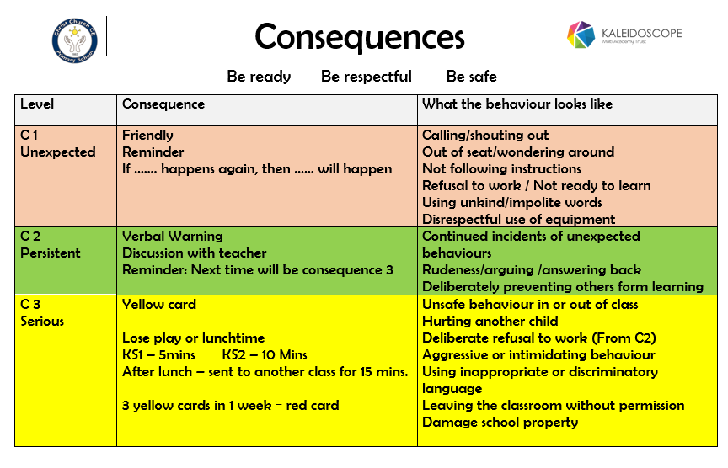
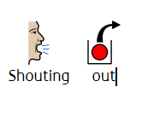
Classroom Pupils version
Work is underway to create a version using pictures or symbols so everyone can access.

Slide 16


