Slide 1
Our British Values Day

Slide 2
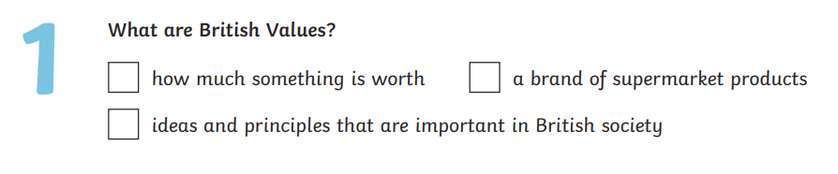

1
3
2

Slide 3
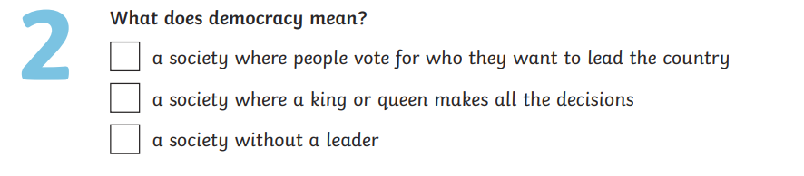

1
2
3

Slide 4
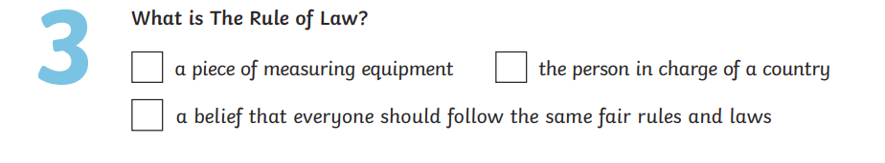

1
3
2

Slide 5
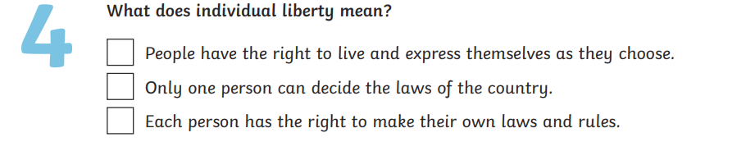

1
2
3

Slide 6
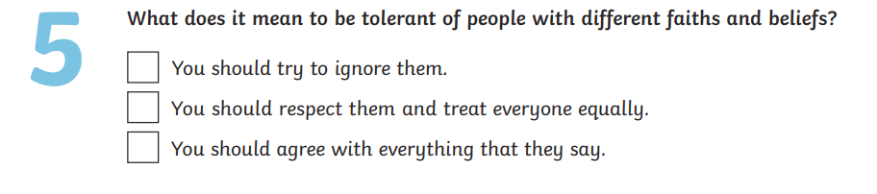

1
2
3

Slide 7
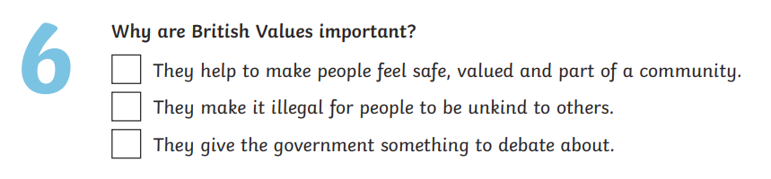

1
2
3

Slide 8
Each year group presents work

Slide 9


